Slide 1
HTML5 and CSS3
Relative Positioning

Slide 2
Implementing Relative Positioning
Page flow: the order of elements in the HTML document
Relative positioning: adjusting default position of an element
Preserves space allotted to element in default page flow
Set position property to “relative”
Style exact location using left and top properties

Slide 3
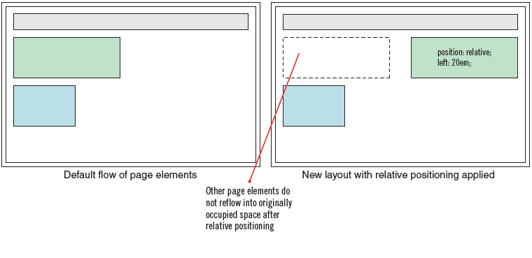
Implementing Relative Positioning (continued)
Relative positioning and page flow

Slide 4
Implementing Relative Positioning (continued)
Relative positioning places an element with respect to where it would statically be positioned. Put another way :-
When an element specifies position:relative; it is initially positioned following the normal flow rules. Surrounding boxes are positioned accordingly. Then, the box is moved according to its offset properties.
And put another way :-
When you relatively position an element, as a developer you are saying to a browser: "hey, take this paragraph, and put it 10 pixels down and 10 pixels to the right of where it would normally be."

Slide 5
Implementing Relative Positioning (continued)
If this moves the element into the default position or space of another element, one of two things will happen:
If the other element’s position is absolute or undefined, you will get overlap.
If the other element’s position is also relative, the other element will also move, relative to the position of the first.
Elements that come after a relatively-positioned element behave as if the relatively-positioned element was in its ‘normal flow’ position, even if this means they occupy the same screen space.

Slide 6
Implementing Relative Positioning (continued)
Browser Compatibility
Browsers may differ in how they handle the display of relatively positioned elements when they overlap other content. Unfortunately, the standards specification appears unclear in how this should be dealt with.
Some, will display the positioned element in front of all its siblings. Others, use the default stacking order and will display it in front siblings that proceed it in source order but behind siblings that follow.
The important difference is,
that with absolute positioning, the box is completely removed from the rest of the document, and other boxes are placed as if the element never existed;
with relative positioning, other boxes behave as if the element was always there.

Slide 7
Descendant Positioning
Relatively positioned elements may or may not establish a new containing block for positioned (relative or absolute) descendant elements. They follow the same rules as non-positioned elements.
If the relatively positioned element is a block element, it establishes a new containing block. Positioned elements within it will use the "offset" position of that element as a base for positioning. In other words, the offsets of descendant elements are compounded.
If the relatively positioned element is an inline element, its offsets are not combined with the offsets of its positioned descendants. Instead they are based on the same containing block used by the relatively positioned element.
Due to disparities, always use block elements for relative positioning.

Slide 8
Relative positioning is commonly used …
Since it’s only the rendered box that moves when we relatively position an element, this positioning scheme isn’t useful for laying out columns of content.
Relative positioning is commonly used …
when we need to shift a box a few pixels or so.
a relatively positioned element is “positioned,” which means it becomes the containing block for any absolutely positioned descendants. This gives us an easy-to-use tool for controlling the position of our containing blocks: just set position to relative without moving the box at all.

Slide 9
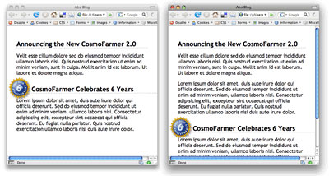
When to use Relative & Absolute together
You may not always want to place something in relation to the browser window. For example, say you have a graphic that's associated with a headline .
When you want an absolutely positioned element to move in relation to a parent tag, use relative positioning on the parent.

Slide 10
When to use Relative & Absolute together
Lets do an example…
If you use absolute positioning on its own, the image would be placed in relation to the browser window, so if the headline moved -- maybe you added an extra paragraph of text above the headline -- the image would stay in the same location in the browser window.
In other words, the image wouldn't move along with the headline.
This is where relative positioning comes in.
Unfortunately, this is one of the most misunderstood CSS concepts. Many people think you apply relative positioning to the element that you wish to position relative to some other element -- for example, apply a relative position to the image since you want to place it relative to the headline. But that's not how it works.

Slide 11
When to use Relative & Absolute together
Instead, you set the position property of an ancestor of that element (the image) to relative.
(An ancestor tag surrounds another tag; for example, if a link is inside a paragraph, the paragraph is an ancestor of the link.)
The relatively positioned element then provides the positioning context for any absolutely positioned tags inside it.

Slide 12
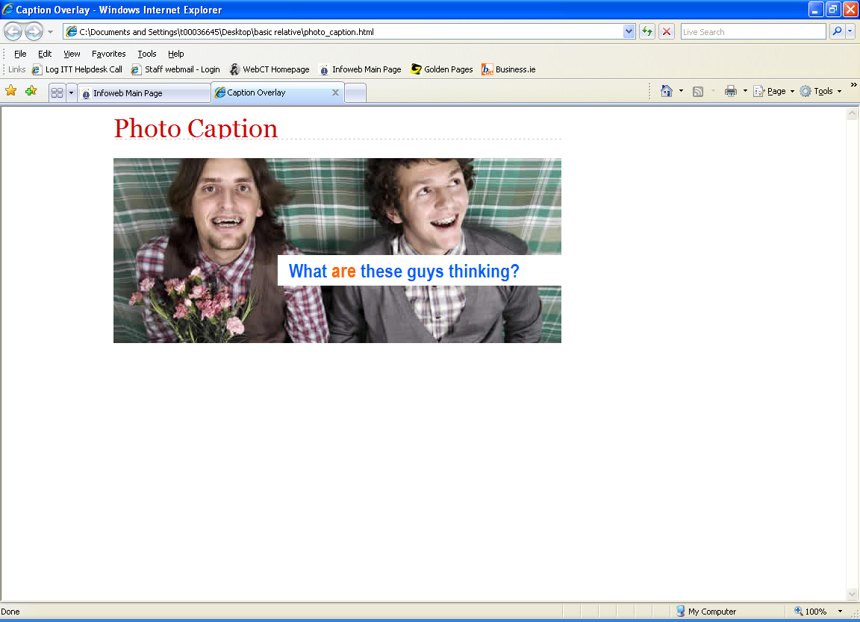
Put the logo
“What are these guys thinking ?”
on top of the image and
position it so that
no matter how much
extra text is placed above the image
the logo will stay in the
same place.

Slide 13
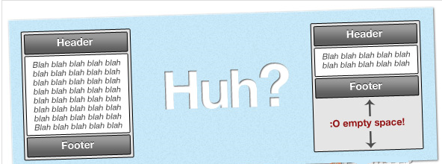
How to keep footer at the bottom of page
Have you ever come across this problem???
http://www.cssreset.com/demos/layouts/how-to-keep-footer-at-bottom-of-page-with-css/

